Slide 1
Section 6.4 Polynomials with Complex roots
© Copyright all rights reserved to Homework depot: www.BCMath.ca

Slide 2
Review of Vieta’s formula?
When given a polynomial in the form of:
These formulas will relate the coefficients with the roots

Slide 3
Practice: Vieta’s Formula
Q: Given that 2 roots of cubic function is 5 and 2, what is the third root?
Q: What are the values of “B” and “C”?

Slide 4
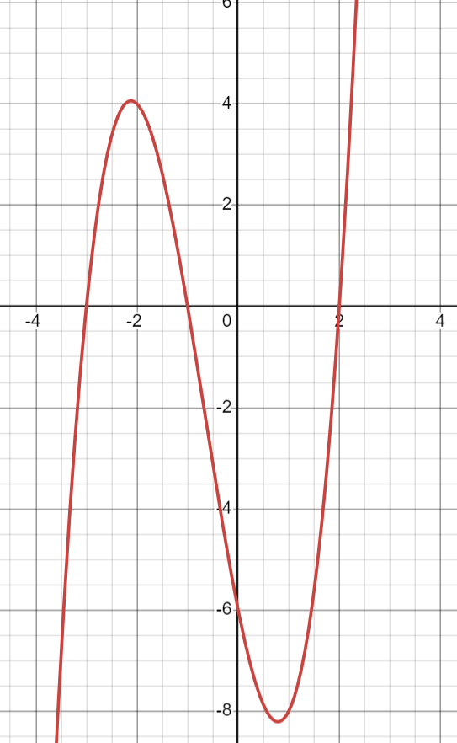
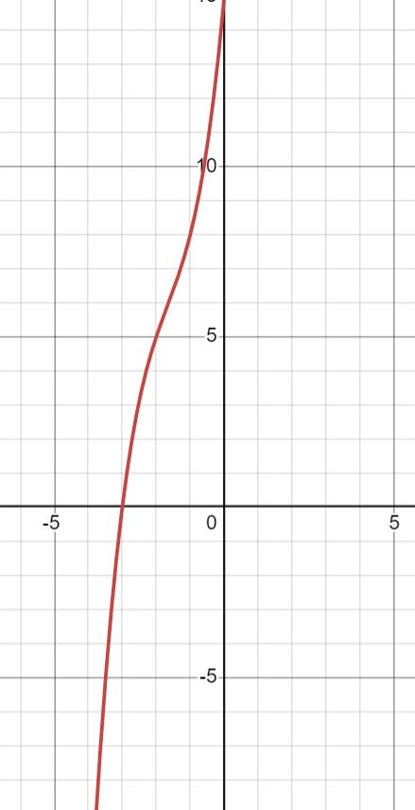
Review: Polynomials and Roots
When we have a polynomial in the form: y=(x+3)(x-2)(x+1), this a cubic function with 3 roots [3 x-intercepts at -3, 2, and -1]
When we have a cubic function with only 1 x-intercept, this is because the other two roots are complex roots
This cubic function has 3 X-intercepts and therefore 3 real roots
This cubic function has 1 x-intercept. Therefore, it has 1 real root and 2 complex roots

Slide 5
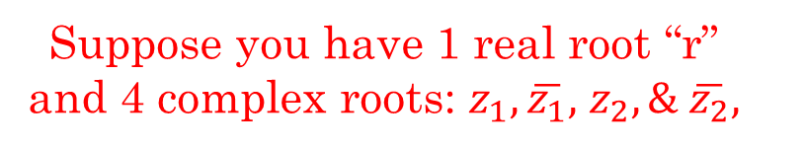
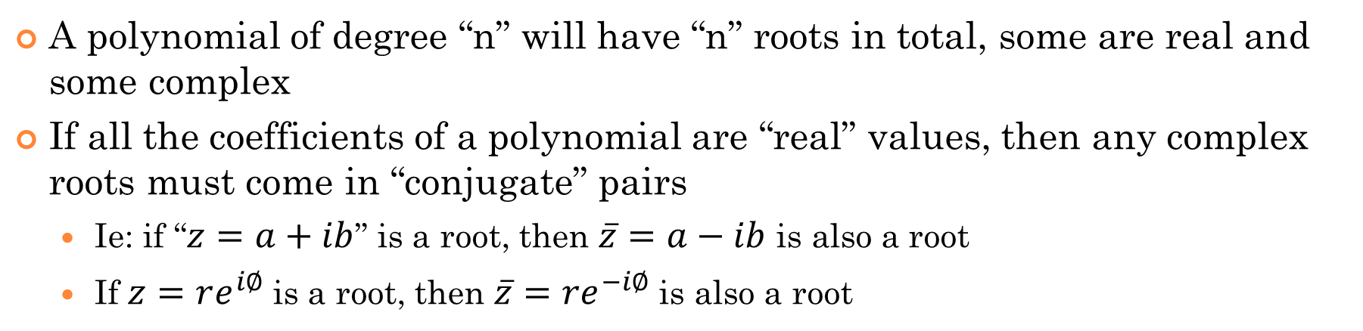
Rules with Polynomials and Complex Roots
A polynomial of degree “n” will have “n” roots in total, some are real and some complex
If all the coefficients of a polynomial are “real” values, then any complex roots must come in “conjugate” pairs
Ie: if “$z=a+ib$” is a root, then $\overline{z}=a−ib$ is also a root
If $z=re^{i∅}$ is a root, then ${\overline{z}=re}^{−i∅}$ is also a root
All Vieta Formulas apply with complex roots
Ie: Suppose you have a polynomial with real coefficients,
Suppose you have 1 real root “r” and 4 complex roots: $z_{1},\overline{z_{1}},$ $z_{2}, \& \overline{z_{2}},$

Slide 6
Ex: Given the polynomial, which of the following are the roots?

Slide 7
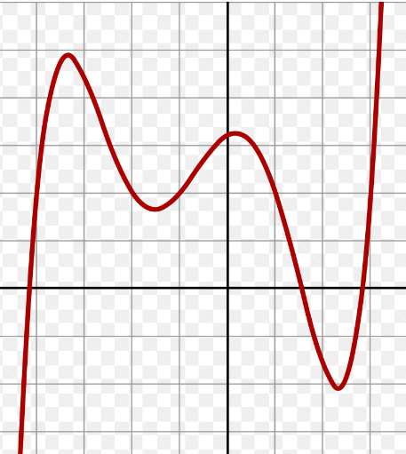
Ex: Given the graph of the quintic function with all real coefficients, how many real and non real roots are there?

Slide 8
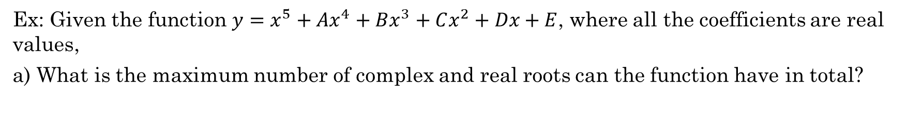
Ex: Given the function $y=x^{5}+Ax^{4}+Bx^{3}+Cx^{2}+Dx+E$, where all the coefficients are real values,
a) What is the maximum number of complex and real roots can the function have in total?
According to the Fundamental theorem of Algebra, a polynomial of degree 5 will have exactly 5 roots. These roots can be either real or non-real [complex]
b) What are the possible number of combinations of real and complex roots the function can have?
Since all the coefficients are real, then the complex roots must come in pairs as conjugates. This way, the imaginary components of each roots will cancel out when expanding.
So the number of combinations are:
5 real roots,
3 real roots and 2 complex roots
1 real roots and 4 complex roots
c) Suppose that the coefficients are not all real values, then how many combinations of real and complex roots are possible?
If the coefficients are not all real values, then the complex roots do not need to come in pairs as conjugates:
5 real and 0 complex
3 real and 2 complex
1 real and 4 complex
4 real and 1 complex
2 real and 3 complex
0 real and 5 complex

Slide 9
Practice: Indicate the number of real and Imaginary Roots for the following Polynomials. Solve for all the roots:

Slide 10
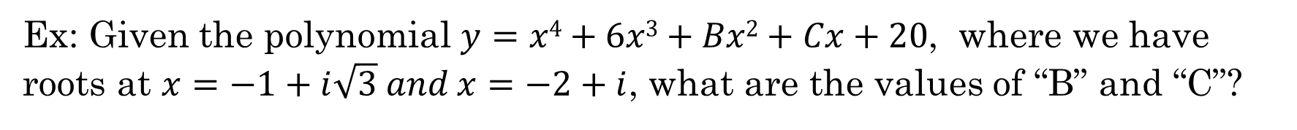
Ex: Given the polynomial $y=x4+6x3+Bx2+Cx+20$, where we have roots at $x=−1+i\sqrt{3} and x=−2+i$, what are the values of “B” and “C”?

Slide 11
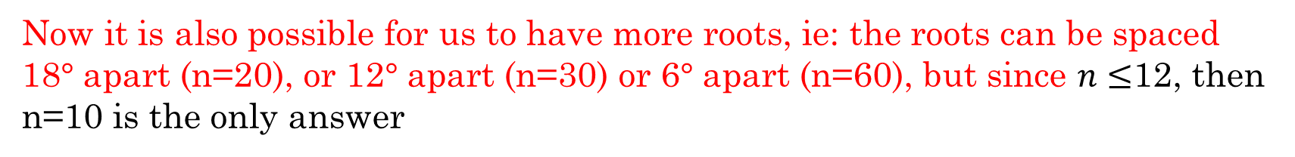
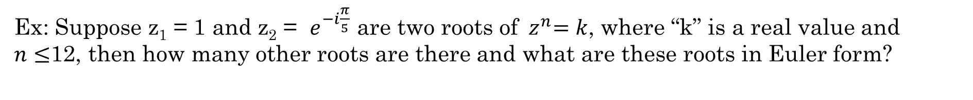
Ex: Suppose z₁ = 1 and z₂ = $e^{−i\frac{π}{5}}$ are two roots of${ z}^{n}=k$, where “k” is a real value and $n≤$12, then how many other roots are there and what are these roots in Euler form?
We know from the Unity of Roots, that all the roots are equally spaced out around the origin
Since z₁ = 1, then length of all the roots are 1 unit away from the origin
We know that z₂ is rotated 36 degrees from z₁
All the other complex roots will be equally spaced out by 36 degrees apart!
So we have 10 roots and these are the value of the 10 roots:
Now it is also possible for us to have more roots, ie: the roots can be spaced 18$°$ apart (n=20), or 12$°$ apart (n=30) or 6$°$ apart (n=60), but since $n≤$12, then n=10 is the only answer

Slide 12
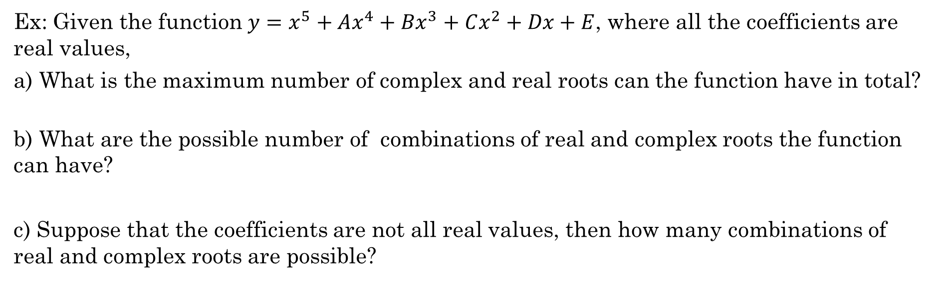
Ex: Suppose z₁ = 1 and z₂ = $e^{−i\frac{π}{5}}$ are two roots of $y=Ax^{n}$, where “A” is a real value and $n≤$12, then how many other roots are there and what are these roots in Euler form?
Ex: Given the function $y=x^{5}+Ax^{4}+Bx^{3}+Cx^{2}+Dx+E$, where all the coefficients are real values,
a) What is the maximum number of complex and real roots can the function have in total?
b) What are the possible number of combinations of real and complex roots the function can have?
c) Suppose that the coefficients are not all real values, then how many combinations of real and complex roots are possible?

Slide 13
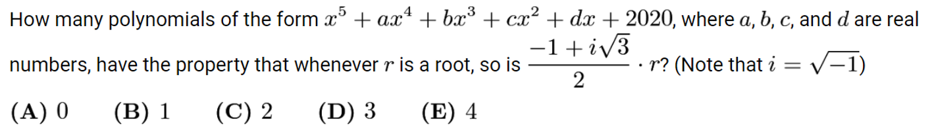
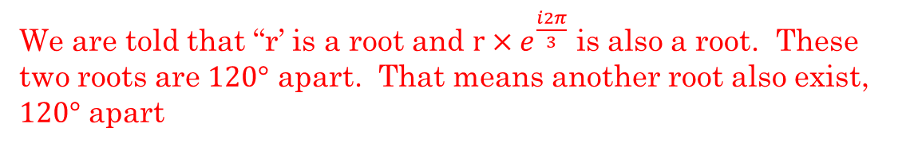

First, convert $\frac{−1+i\sqrt{3}}{2}$ to Euler form
We are told that “r’ is a root and $r×e^{\frac{i2π}{3}}$ is also a root. These two roots are $120°$ apart. That means another root also exist, $120°$ apart
So your roots are going to be:
Since the polynomial is degree 5, there has to be 5 roots altogether
So, that means that you can’t have another set of 3
So the roots that we have needs to be either double or triple roots
Since all the coefficients are real values, then your complex roots must come in pairs as conjugates. It also turns out that are conjugates
So the number of possible polynomials are:
So only two polynomials are possible

Slide 14
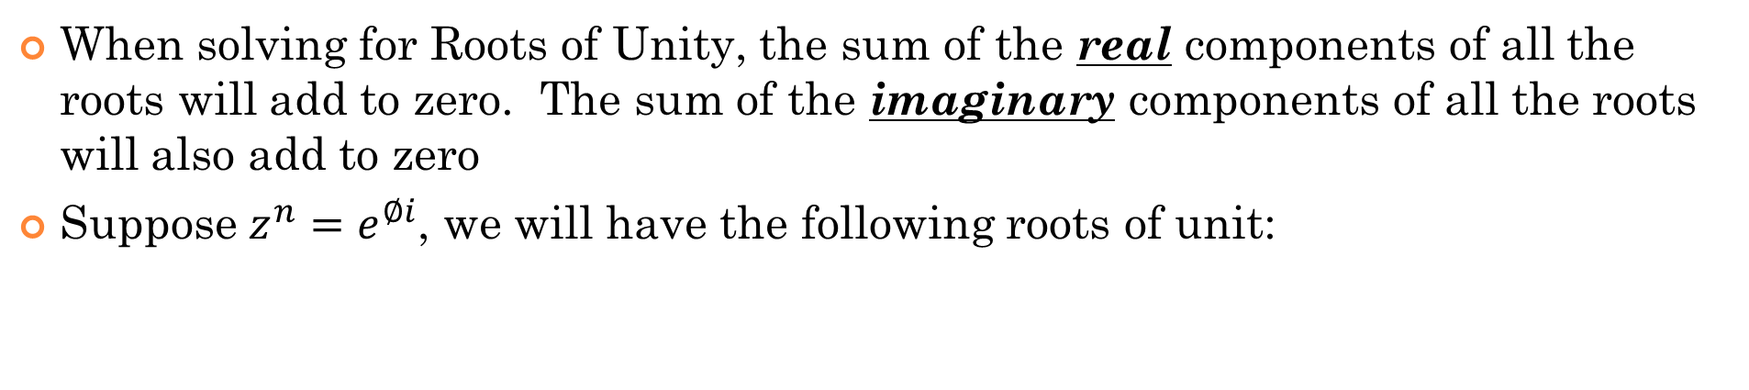
Roots of Unity and Polar Form:
When solving for Roots of Unity, the sum of the real components of all the roots will add to zero. The sum of the imaginary components of all the roots will also add to zero
Suppose $z^{n}=e^{∅i}$, we will have the following roots of unit:
The real components of all the roots of unity will be:
The sum of all these real components will be zero!
The sum of all the imaginary components will also be zero!

Slide 15
Ie: Suppose we have $z^{5}=e^{−150°i}$ , the five roots of unit will be:
The sum of these 5 REAL components of the Roots of Unity is equal to ZERO!!
The sum of these 5 IMAGINARY components of the Roots of Unity is also equal to ZERO!!
When the angles are presented equally around in an unit circle, we can use the Roots of Unity to find the sum of these angles

Slide 16
Ex: Given that $z^{5}=1$, what is the exact value of $cos72°+cos216°$ without using a calculator?
Ex: What is the exact value of $sin165°+sin285°+sin45°$ without using a calculator?
Ex: Given that $z^{7}=1$, what is the exact value of $cos\frac{6π}{7}+cos\frac{4π}{7}+cos\frac{12π}{7}$ without using a calculator?

Slide 17
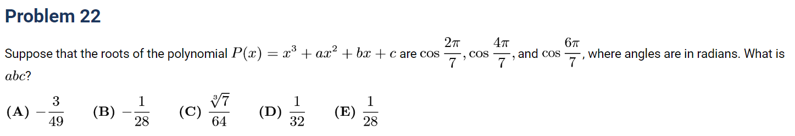
If we use Vieta, we get the following formulas:
Using the roots of unit:
Use trig identity:

Slide 18
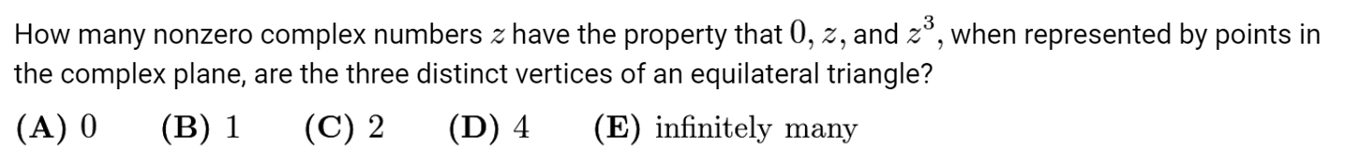
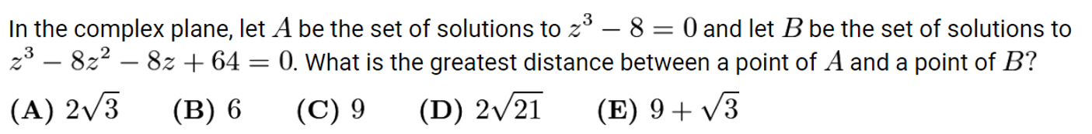

Slide 22
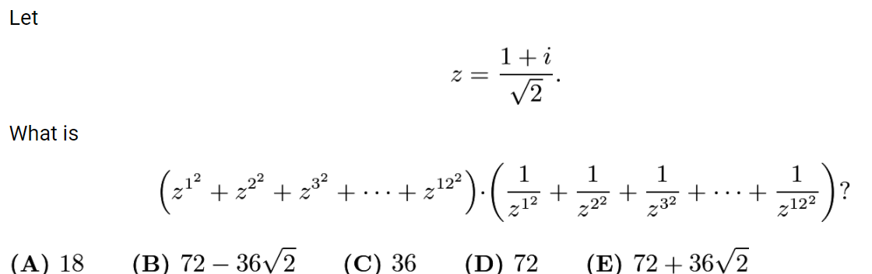
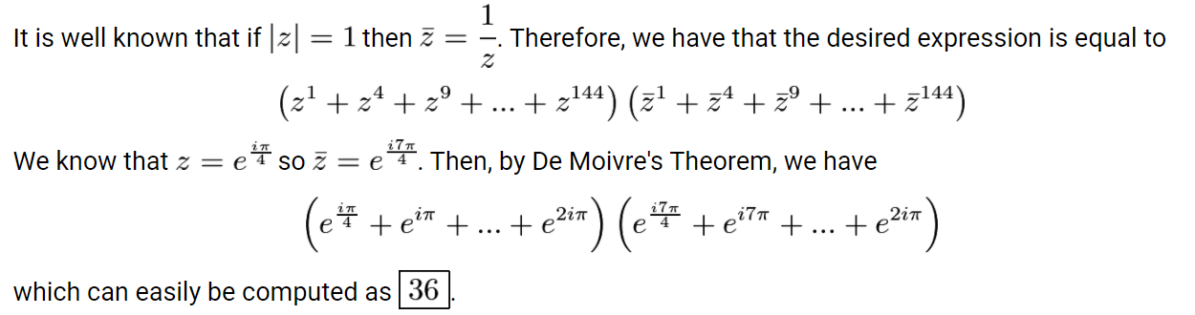
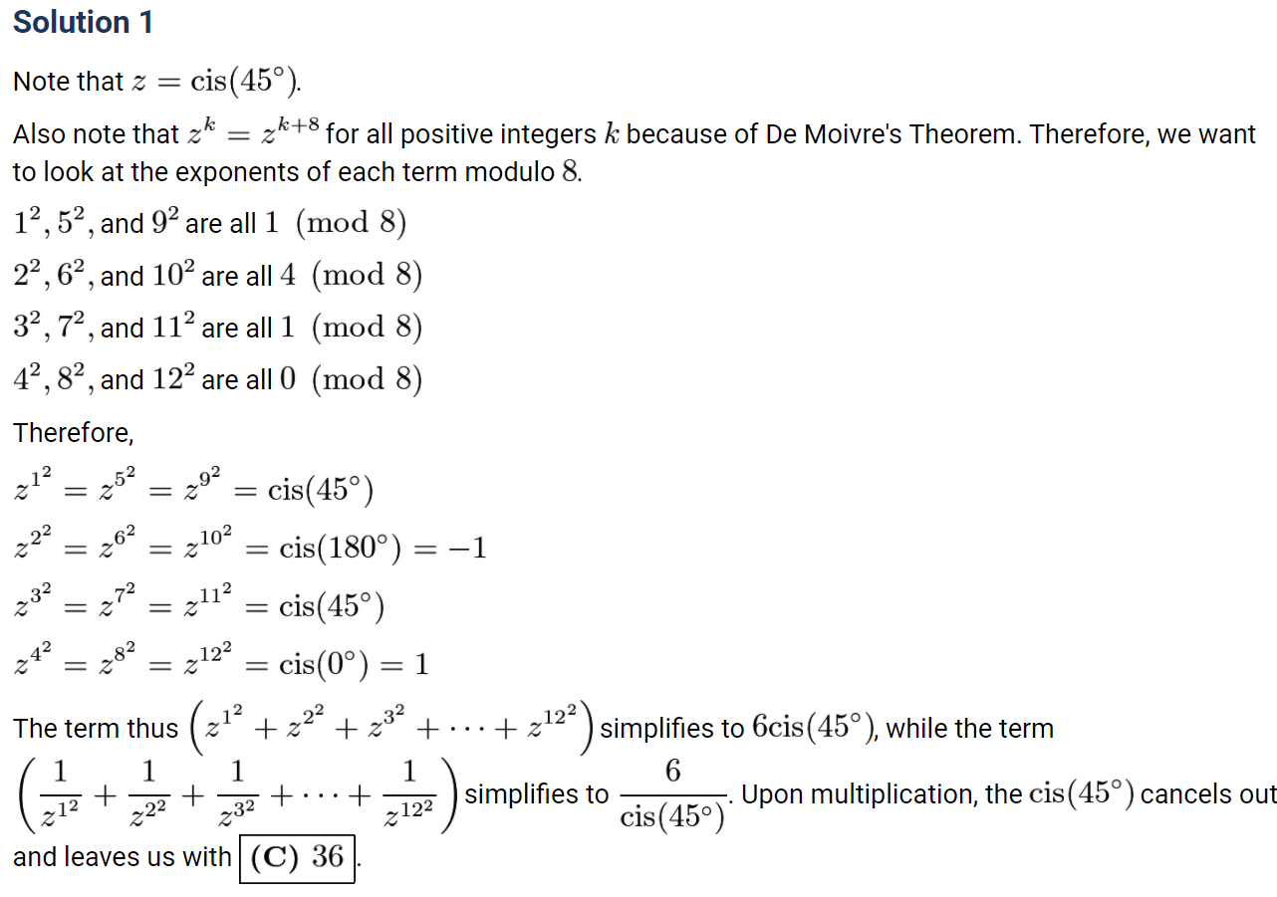

Slide 24
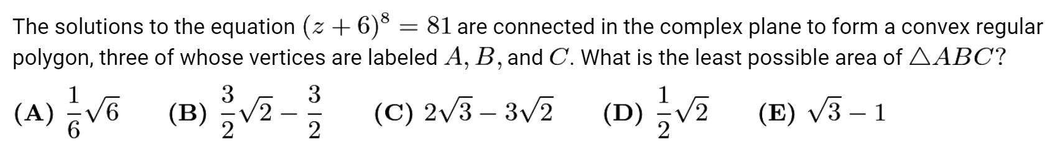
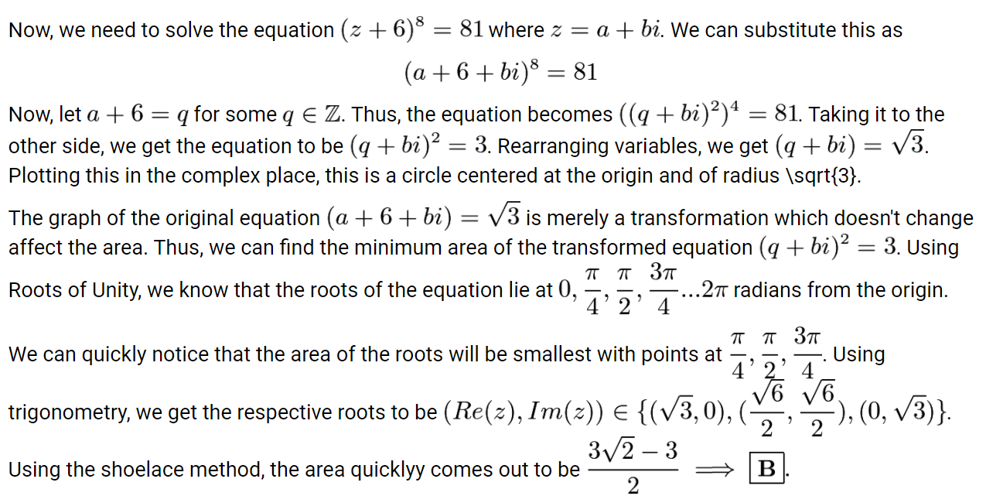

Slide 25
a) Simplify each of the following and find the real and imaginary component

Slide 26
Match each expression on the left with the corresponding value on the right:

Slide 27
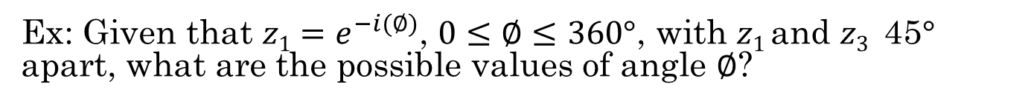
Ex: Given that $z=2e^{−i(25°)}$, then draw the following:
Ex: Given that $z1=e^{−i(∅)}$, $0≤∅≤360°$, with $z1$and $z3$45$°$ apart, what are the possible values of angle $∅$?

